Slide 1
Precision VR: The Ultimate Gun Range
By: William M, Tyler C, and Shane L

Slide 2
Our goal was to create a VR Gun Range that could scale proportionally with our development knowledge as the semester progressed.

Slide 3
Project Overview
Created an engaging VR gun range with four game modes: Tactical Destruction, Casual Target Practice, Speed Test, and Accuracy Test
Designed a central hub world as a seamless interface for users to navigate between experiences
Built with scalability in mind, allowing for future expansions into new interactive environments

Slide 4

Team Roles
William M.
Tyler C.
Casual Target Practice Environment/Game Mode, & Speed Test
Project Manager, UI Design, Hub World, & Tactical Destruction
Shane L.
Accuracy Test & Report

Slide 5
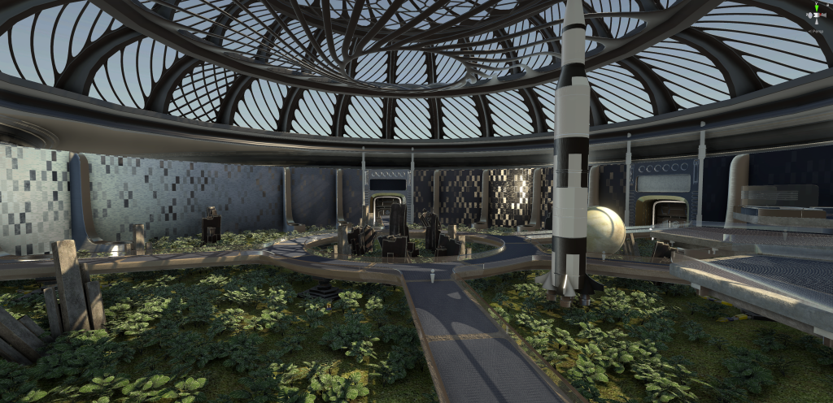
Inspiration
Inspired by Dr. Cruz’s work on creating immersive environments, emphasizing the importance of flexible and scalable designs.
The hub world design draws directly from the concept of themed experiences

Slide 6
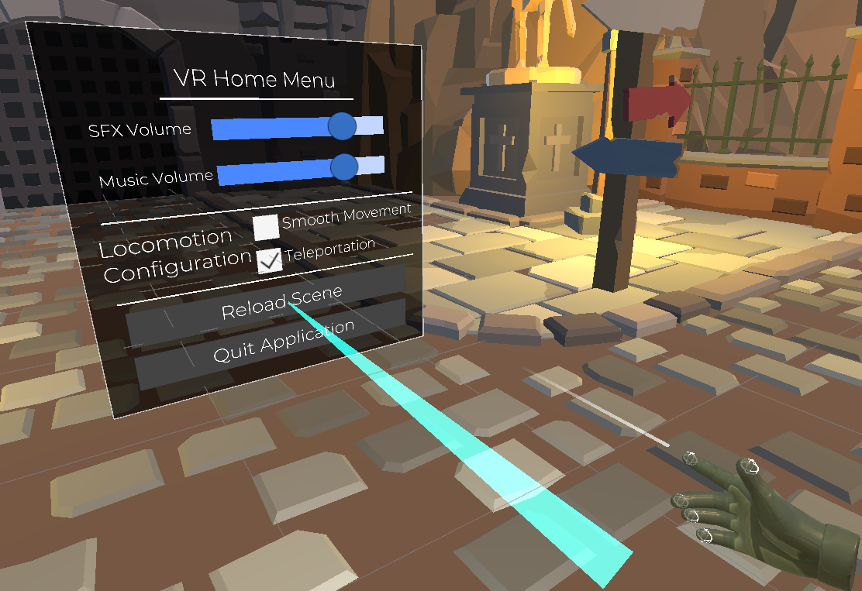
User Experience
Immersive Interaction & Seamless Navigation
The VR experience is designed to prioritize user comfort and engagement, with responsive controls, clear menus, and fluid transitions between game modes.

Slide 7
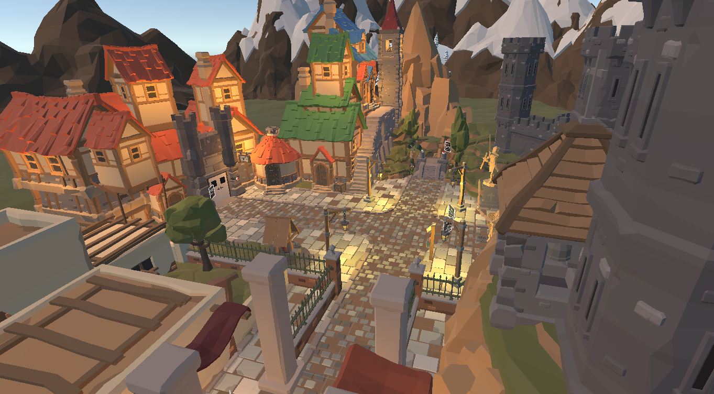
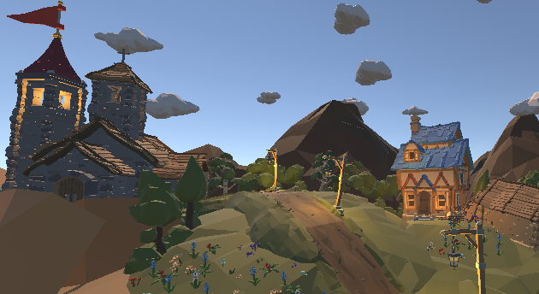
Virtual Space Design
Low-Poly Aesthetic: The environment features clean, geometric designs that balance simplicity with immersive realism.
Medieval Theme: A medieval theme with torches, castle walls, and rustic textures, blending history with VR gameplay.

Slide 8
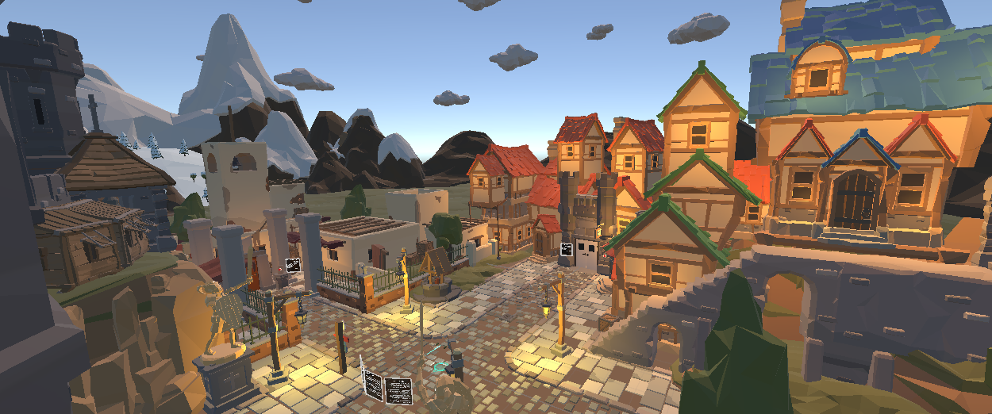
Hub World
Designed as an open area with multiple portals, each leading to a different game mode for the user to explore
Includes user-friendly menus that explain how to interact with the environment and adjust game settings

Slide 9
Gamemodes
Tactical Destruction
Speed Test
Accuracy Test
Casual Target Practice
360 degree fast paced timed target practice
Test speed on a set group of simple targets
Test accuracy on a series of bullseye targets
Freeform Gun Range, Sandbox

Slide 10
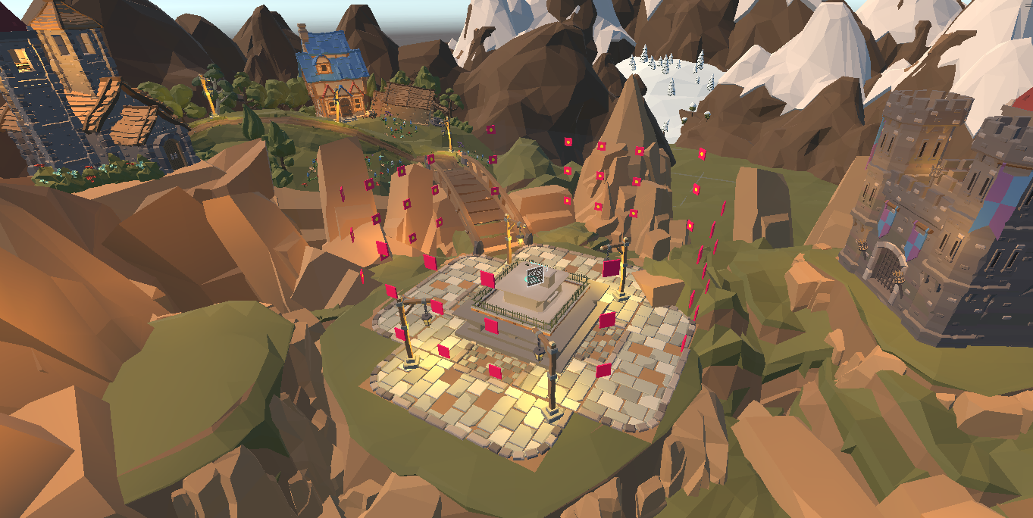
Tactical Destruction
10 Rounds by default, randomly appearing around the user, they must shoot all targets before time runs out to progress.
If all 10 rounds are completed, they may pass enter endless mode.

Slide 11
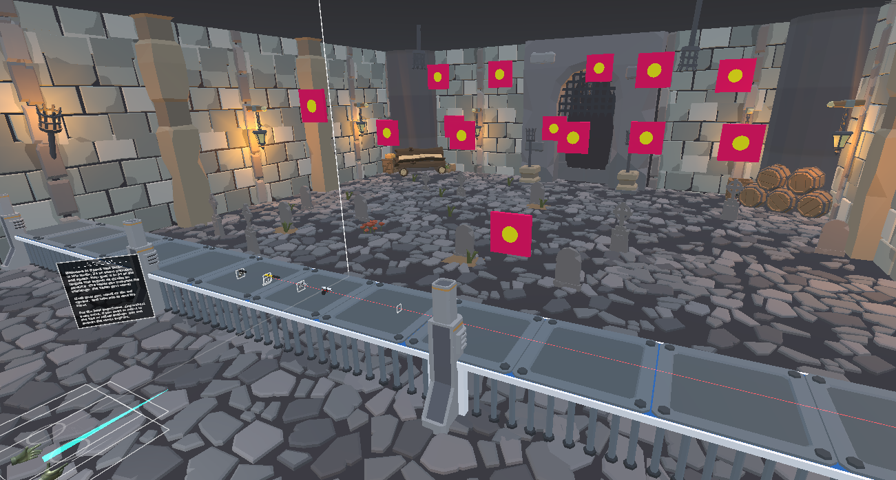
Speed Test
Aims to test user’s gun speed
Targets appear and the user shoots all targets while timed

Slide 12
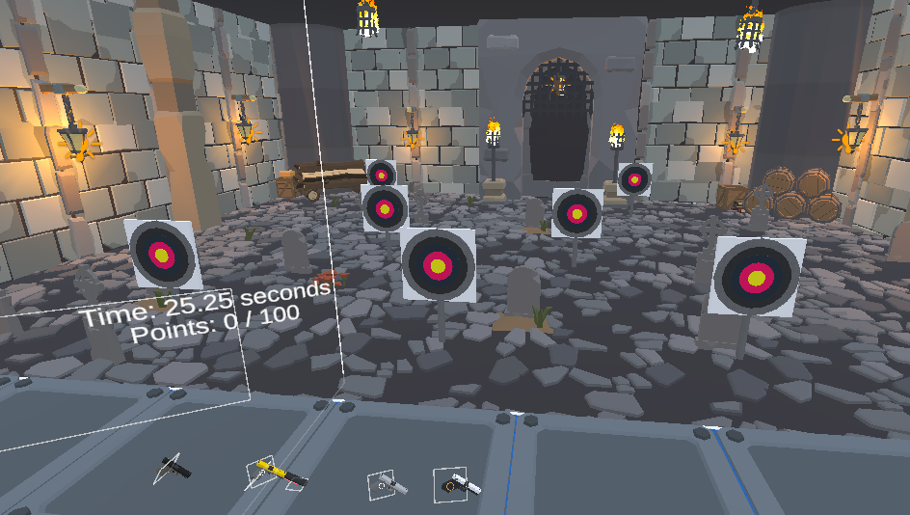
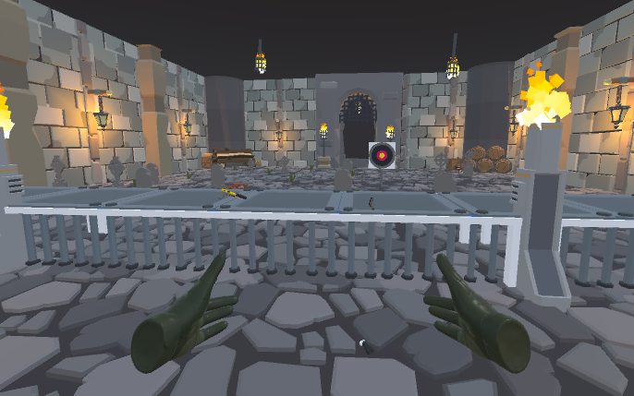
Accuracy Test
Aims to test user’s skill and accuracy whilst shooting
Targets appear differently for each level and can rise/fall from view

Slide 13
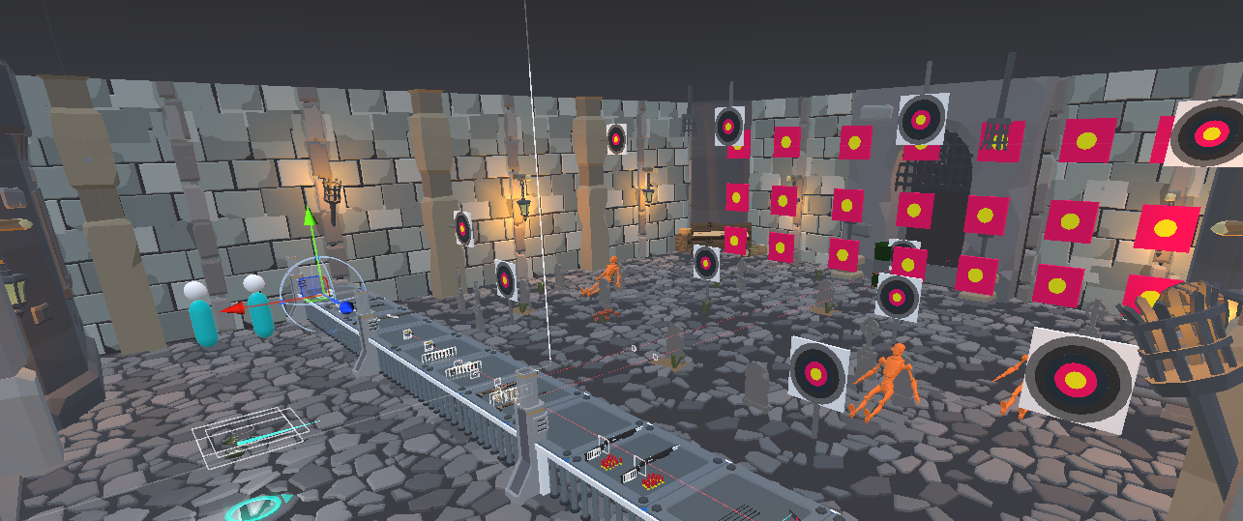
Casual Target Practice
Aims to improve user’s precision and familiarity with weapons and targets.

Slide 14
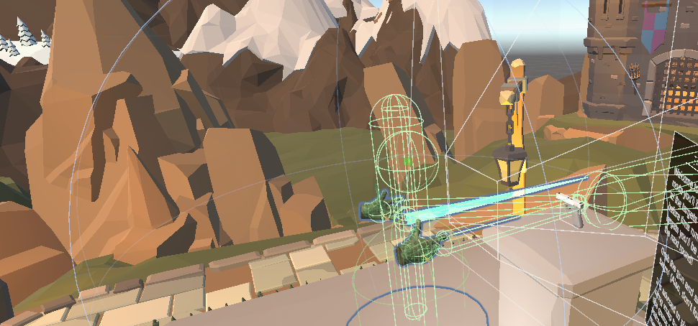
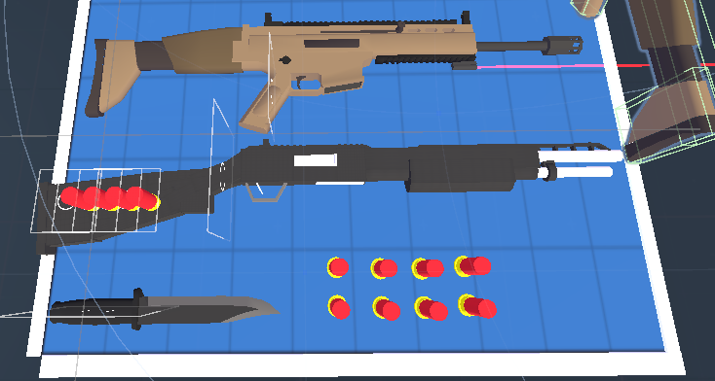
Interactive Components
Weapon Mechanics: Users can physically grab, load, and fire weapons
Responsive UI: Menu allow users to select game modes, weapons, and access help or exit seamlessly within the VR environment
XR Rig Integration: Tracks user movements and inputs for precise interactions

Slide 15
Development Process
WEEK 2-4
WEEK 10
WEEK 1 - 2
WEEK 5-9
Version Control & OpenXR setup
Game Mode Creation
Hub World Creation
Testing & Fine Tuning

Slide 16
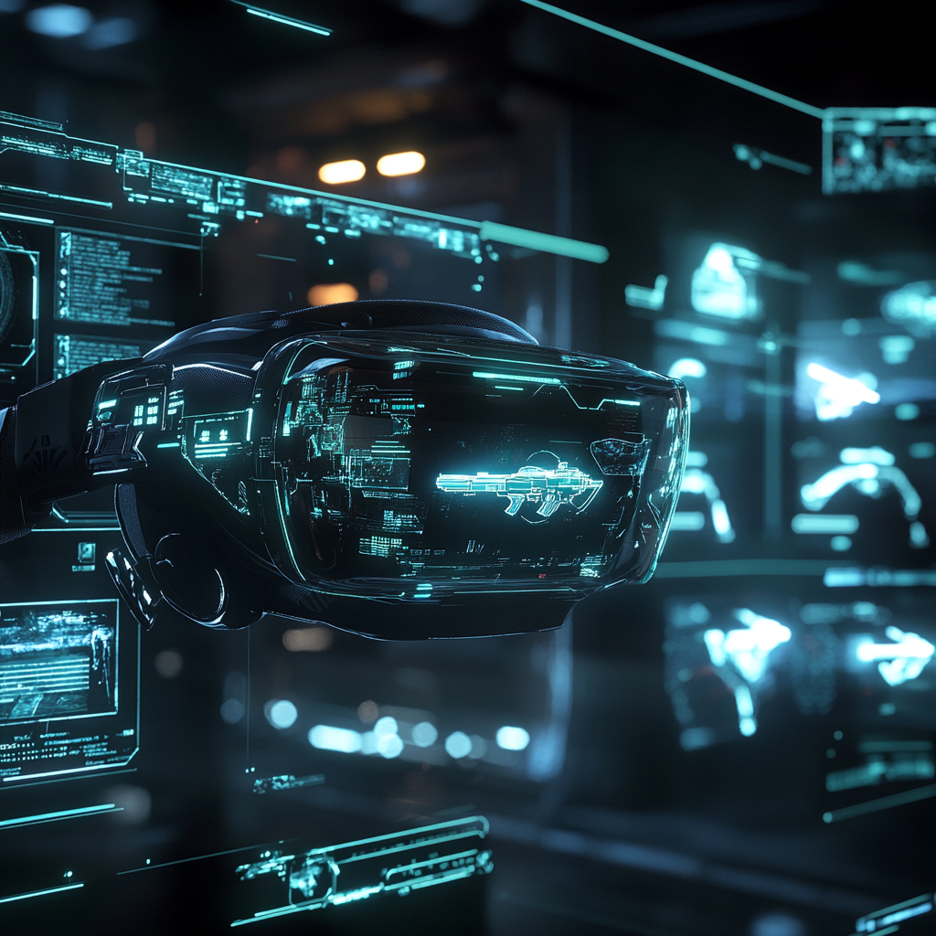
Relation To Class Concepts
Synthesia: Combines visuals and sounds, like breaking targets and realistic weapon effects.
Efficiency Mechanics with Lighting: Low-poly textures and optimized lighting ensure clarity and performance.
Depth Cues: Uses scaling, overlap, and shadows for spatial awareness.

Slide 17
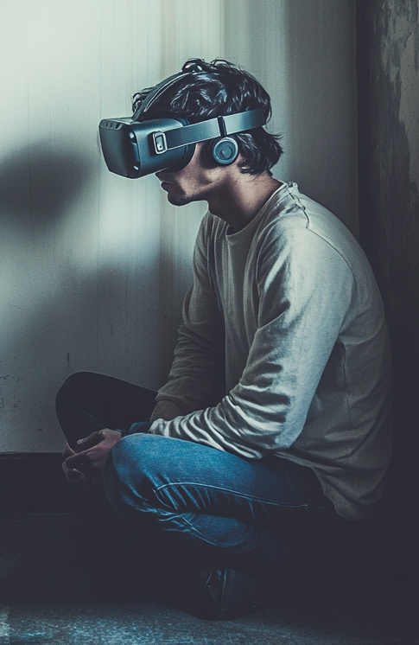
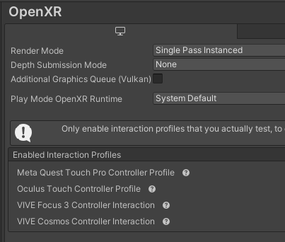
Challenges
Cross compatibility across headsets.
01
02
Detail and playtesting time constraints.
03
Version control carry overs, and integration of third-party packages

Slide 18

Accomplishments
Seamless Scene Transitions.
01
02
Lighting is immersive and well-designed.
03
Weapon mechanics and targets are precise.

Slide 19
Future Expansions
Accuracy/Speed Test can be easily expanded by adding in new levels
Hub World can easily be expanded to have more portals
We could add more Game Modes into the environments already set up (El Presidente, Siege Mode)
Customizable Avatars and Weapons

Slide 20
THANKS
A heartfelt thank you to Dr. Cruz for guidance, support, and inspiration throughout our project journey.

